Slide 1
SECURE FILE SHARING ON CLOUD USING HYBRID CRYPTOGRAPHY
Project GUIDE :
Dr. l. sAi rAMESH
2019272022
MANJULA R.
III – MCA SS

Slide 2
OVERALL ARCHITECTURE
Data Owner
Upload File
Encryption – AES & RSA
SECURE FILE SHARING
Data User
Access File
Decryption – AES & RSA

Slide 3
LIST OF MODULES
User Module
Data-Owner Module
Cloud Storage
Data-User Module

Slide 4
MODULE EXPLANATION
User Module
Registration
Login
REGISTER
User Credentials
DB
LOGIN
Successful

Slide 5
MODULE EXPLANATION (2)
Data Owner & User Module
Upload
Download
Upload
Encrypt
Cloud Storage
Download
Decrypt

Slide 6
MODULE EXPLANATION (3)
Cloud Module
Firebase Registration
Firebase Console
Multiple Buckets
Default Storage Bucket
Storage

Slide 7
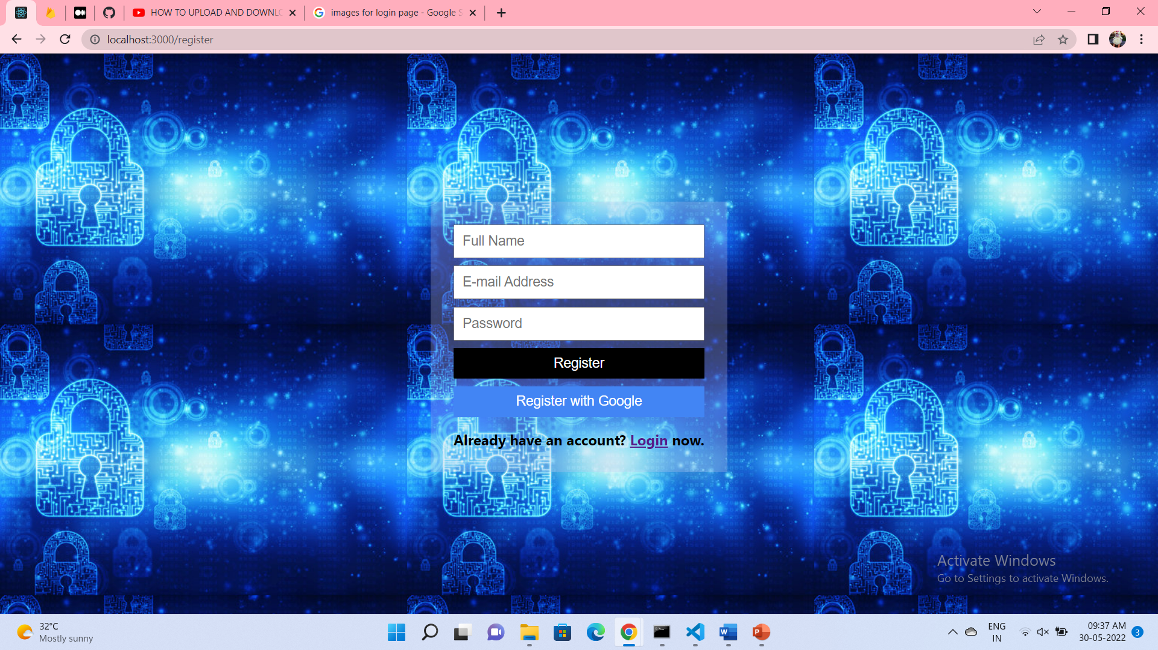
USER MODULE - REGISTER

Slide 8
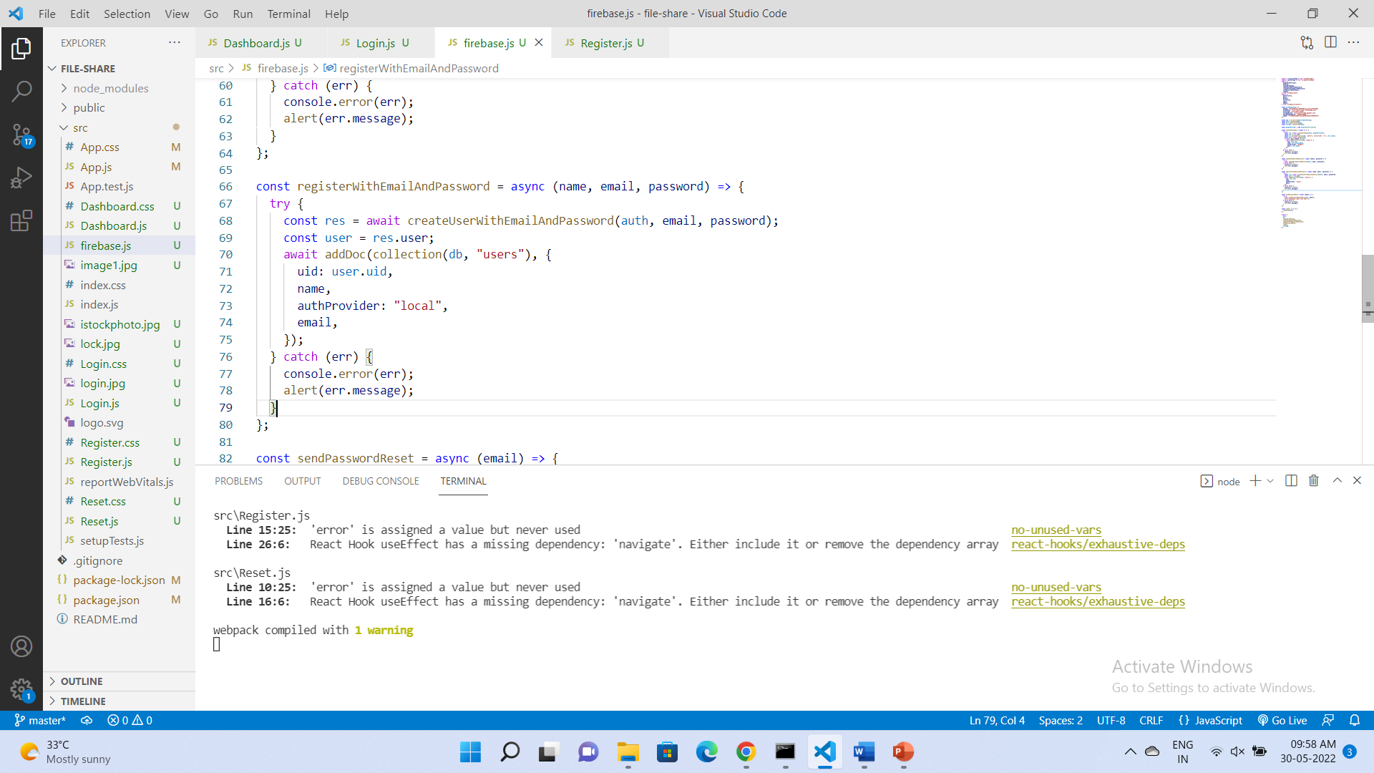
REGISTER TESTCASE

Slide 9
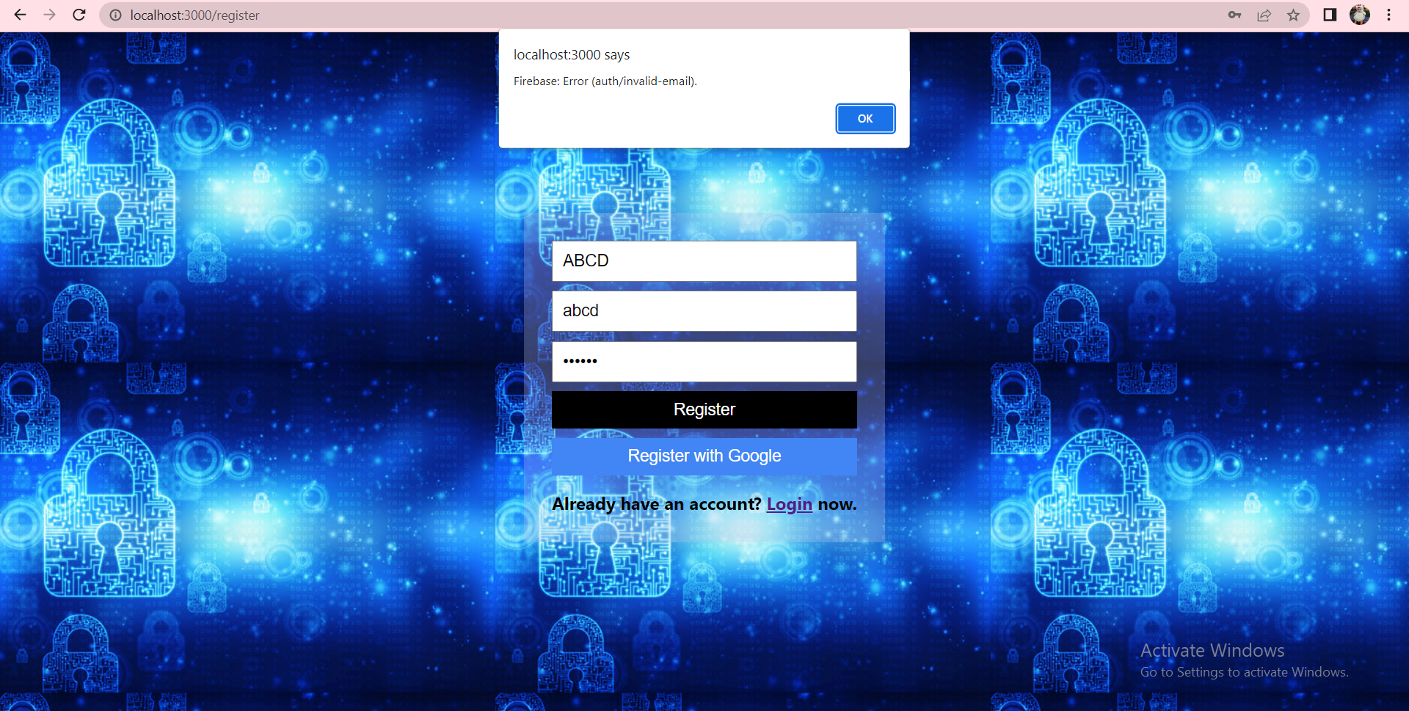
REGISTER TESTCASE OUTPUT

Slide 10
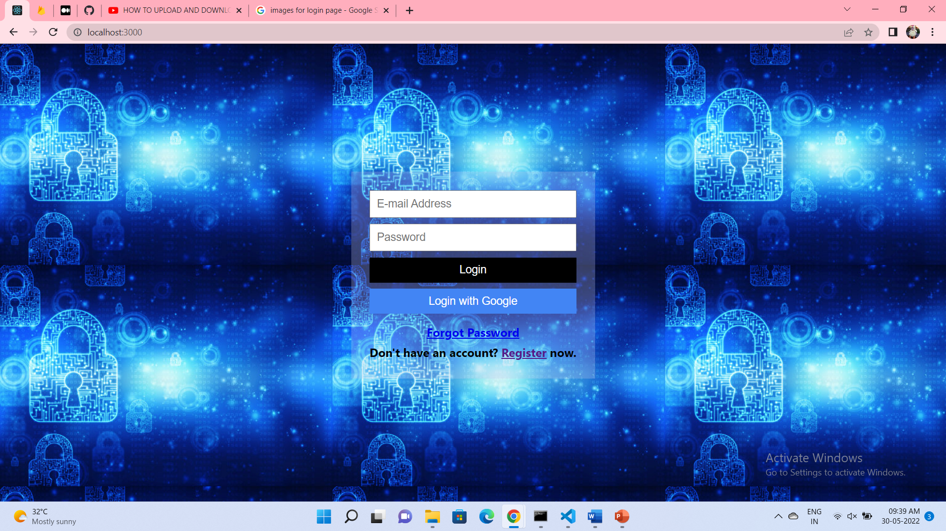
USER MODULE - LOGIN

Slide 11
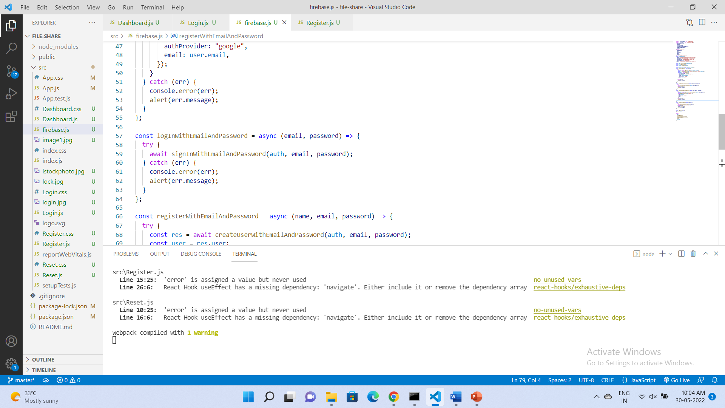
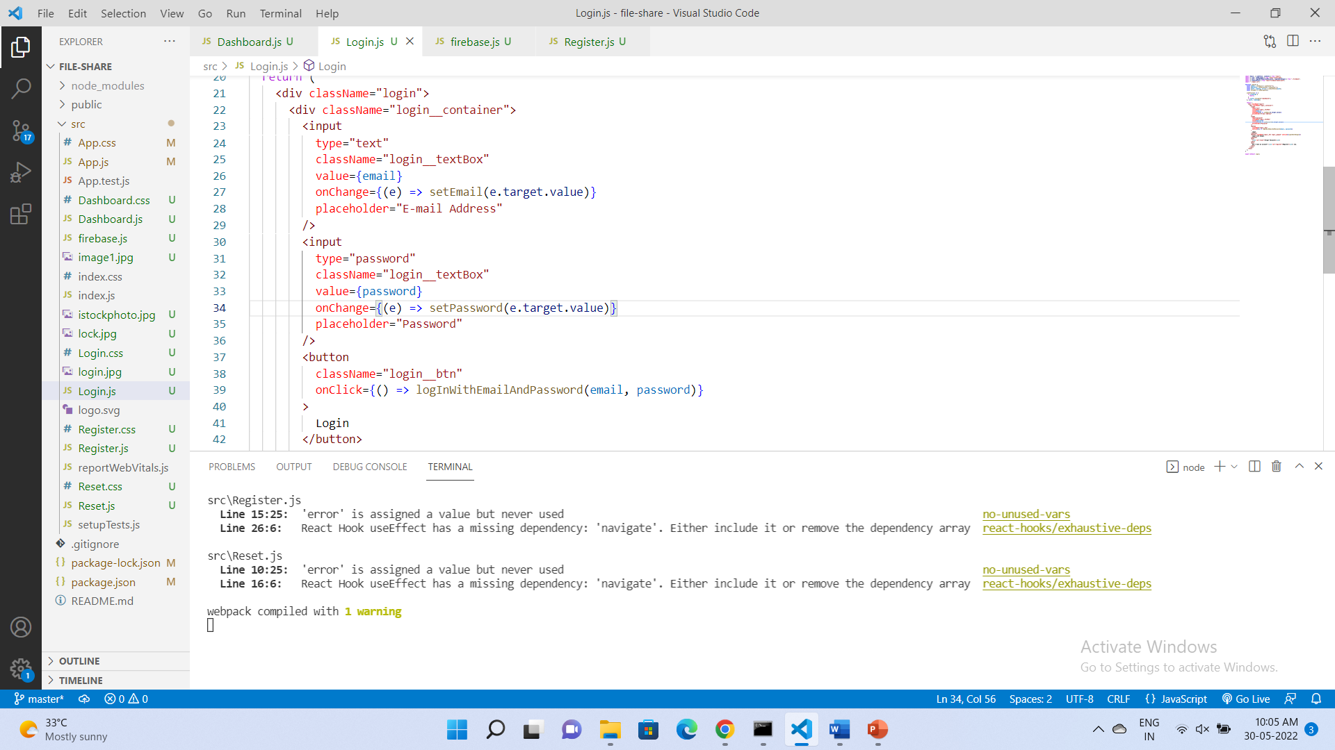
LOGIN TESTCASE

Slide 12
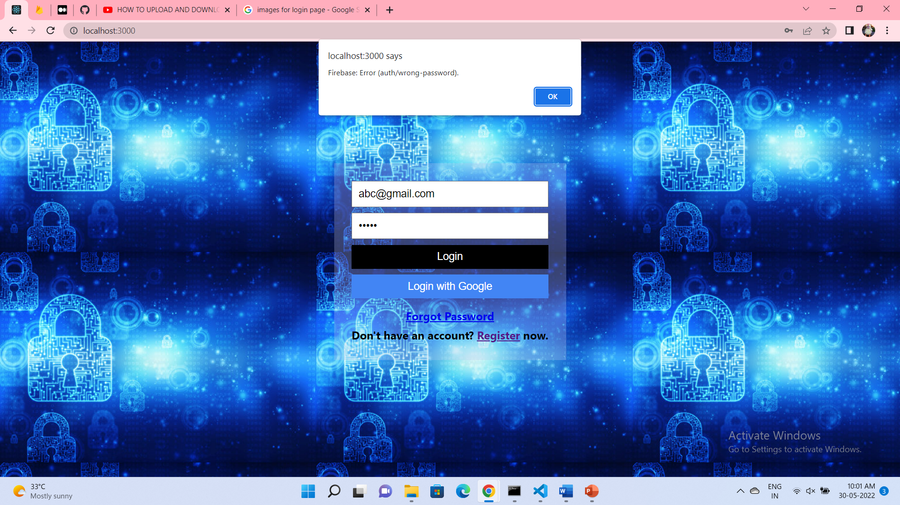
LOGIN TESTCASE OUTPUT

Slide 13
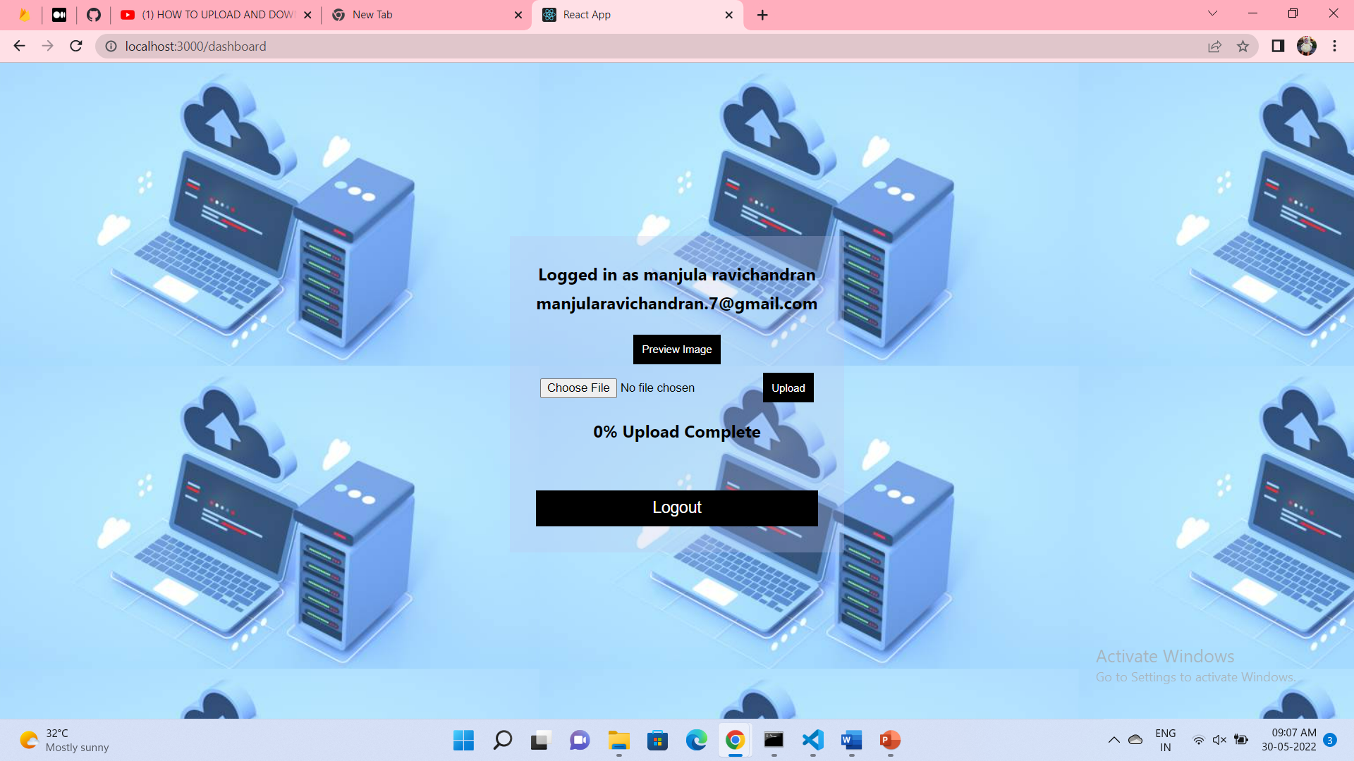
USER MODULE - DASHBOARD

Slide 14
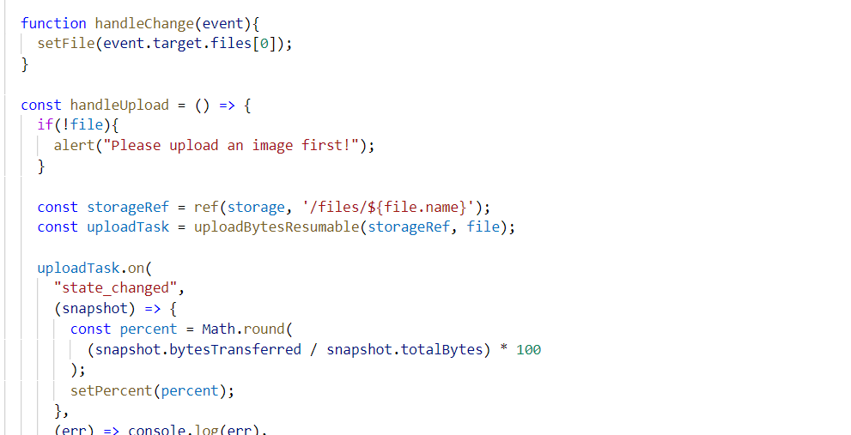
DASHBOARD TESTCASE

Slide 15
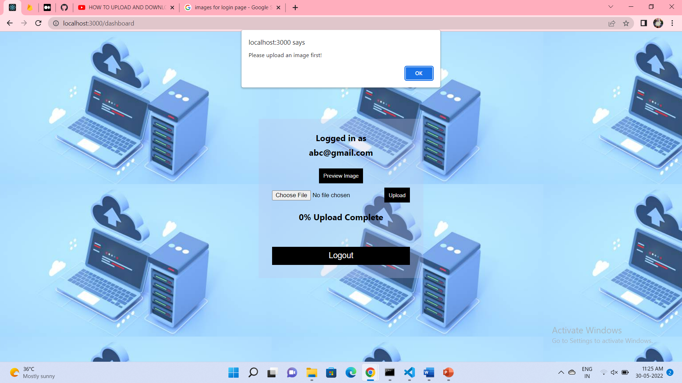
DASHBOARD TESTCASE OUTPUT

Slide 16
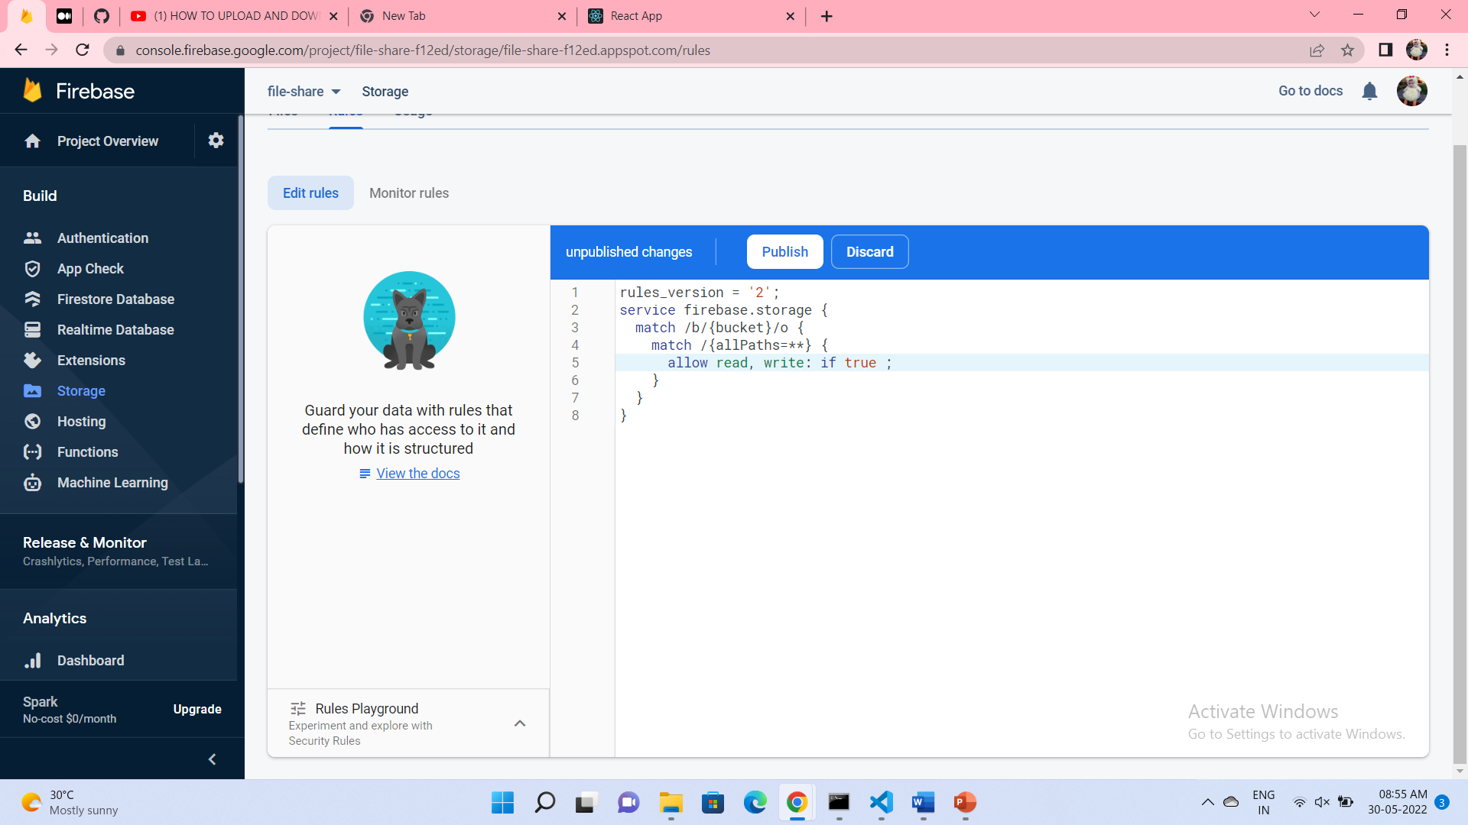
CLOUD MODULE - RULES

Slide 17
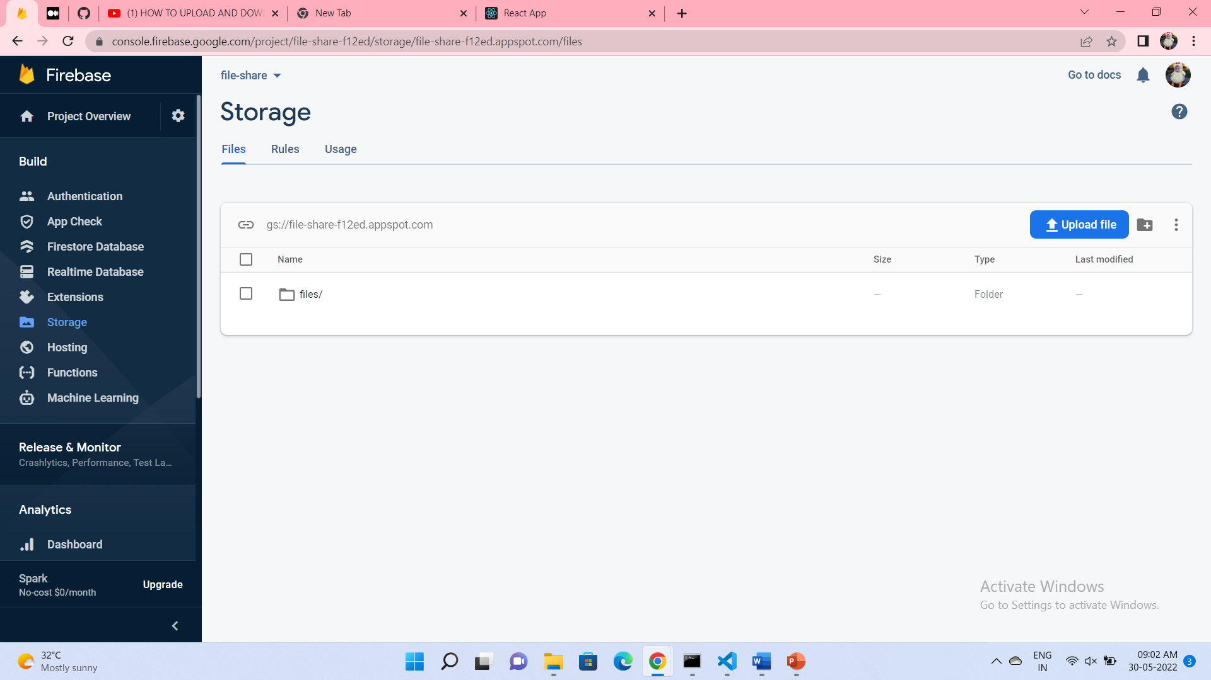
CLOUD MODULE – Default Bucket
Default Bucket for storing files

Slide 18
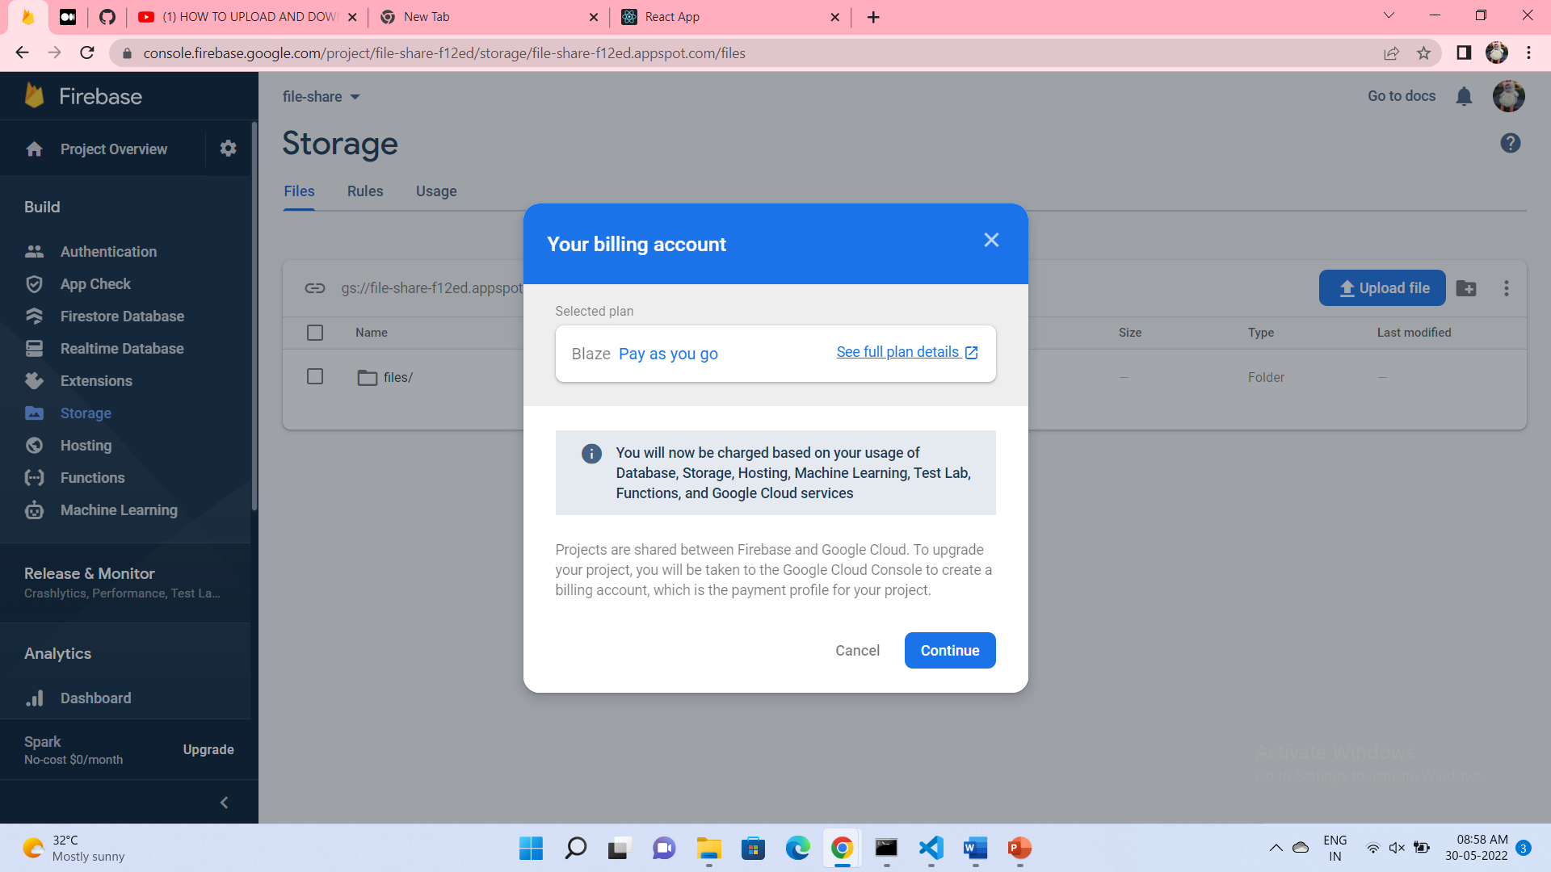
CLOUD MODULE – Multiple Buckets

Slide 19
REFERENCES
File Storage on cloud - https://ijcrt.org/papers/IJCRT2007048.pdf
Secure data sharing for mobile cloud computing using RSA - https://iopscience.iop.org/article/10.1088/1757-899X/1055/1/012108/pdf
Secry – Secure file storage on cloud - https://www.slideshare.net/alinbabu2010/secry-secure-file-storage-on-cloud-using-hybrid-cryptography-236803722

Slide 20
THANK YOU

